Slide 1
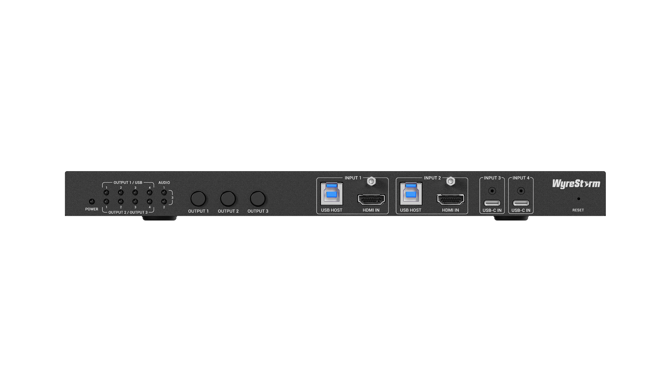
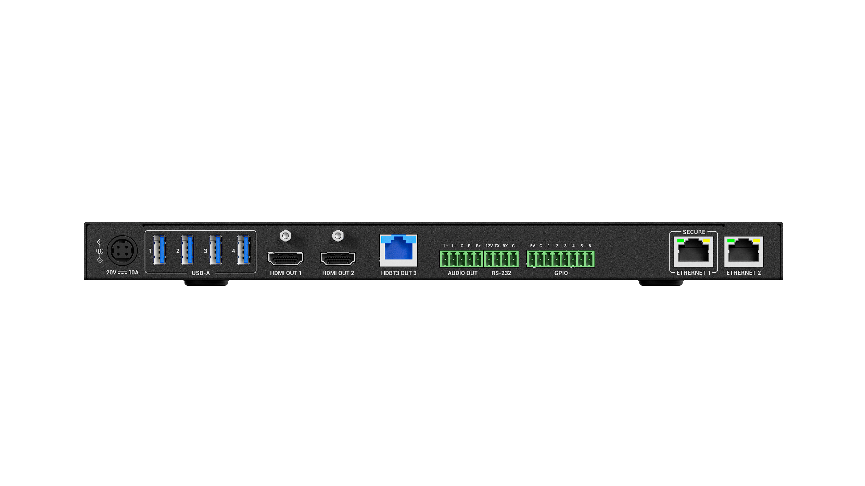
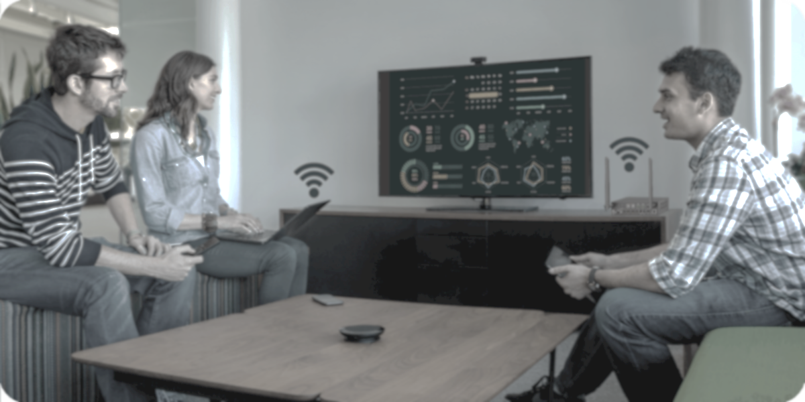

MX-0403-H3-MST
Product Guide
Advanced 4K Conference Presentation Switcher
Award-Winning Audio-Visual Solutions Manufacturer

Slide 2

Contents
Product Overview & Main Features
Why Choose Us?
Interface & Specifications
Typical Connection & Applications
Competitor Analysis
Quick Installation Guide & Web UI Introduction
Q & A Session
Powerful · Reliable · Simple

Slide 3

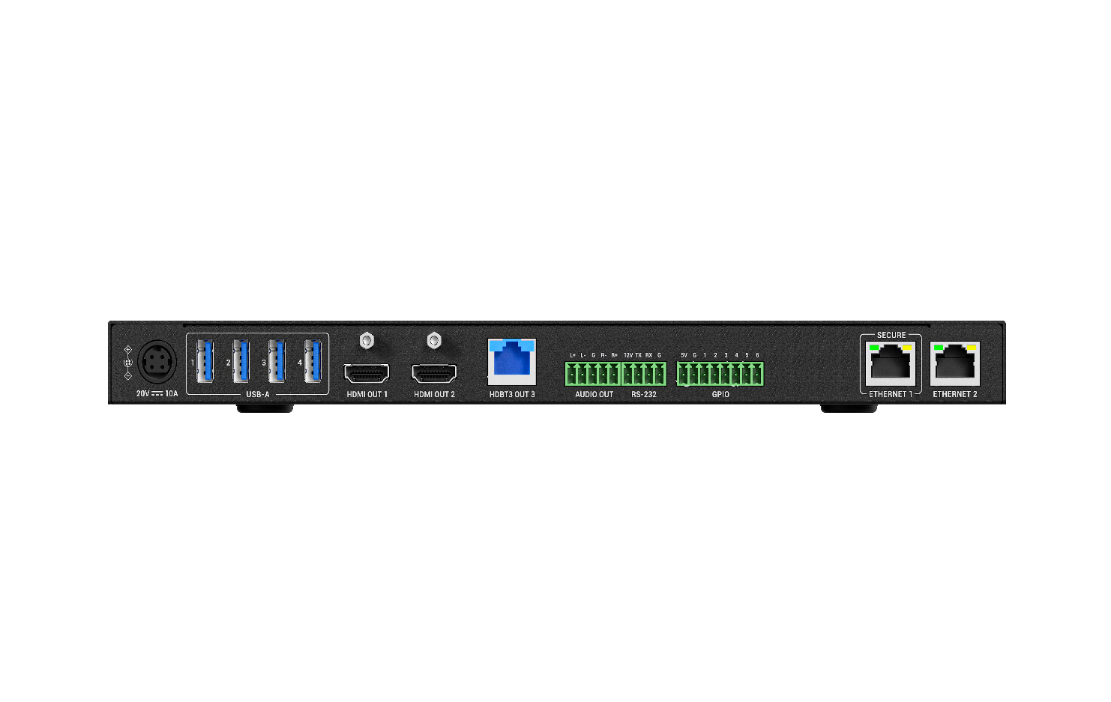
Product Overview
Advanced 4K Conference Presentation Switcher
The MX-0403-H3-MST Conference Presentation Switcher is the ultimate solution for modern mid-to-large conference rooms, designed to simplify and enhance your presentation experience. This all-in-one device integrates video, audio, long-distance transmission, USB, Ethernet, and control functionalities. With dual USB-C and dual HDMI inputs, automatic source switching, and Multi-Stream Transport (MST) capabilities, the MX-0403-H3-MST delivers an immersive and seamless experience for any conference environment. Its advanced HDBaseT output supports long-distance transmission of up to 4K@60Hz 4:4:4 8-bit over 100m via Cat 6a/7 cable, perfectly suited for medium-to-large spaces.
In addition, USB 3.2 ports support transfer speeds of up to 10Gbps, enabling a professional hybrid experience for remote meetings or distance learning. This product is ideal for conference rooms or classrooms seeking an immersive AV environment, advanced hybrid functionality, and versatile control options.
Powerful · Reliable · Simple

Slide 4



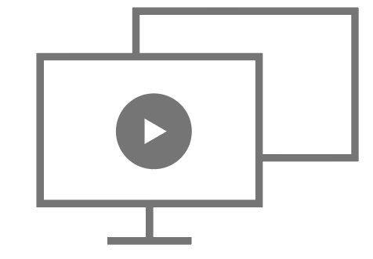





Main Features
Reliable and High-Quality Resolution
4K resolution (4K@60Hz 4:4:4 8bit) guarantees sharp and clear video, delivering a fully immersive presentation experience.
USB-C MST (Multi-Stream Transport) Supports
Supports USB-C MST technology, enabling simplified connections, reduced cabling, efficient resource utilization, and flexible multi-screen configurations. Also aligns with the trend toward slimmer, more streamlined device designs.
Comprehensive Input Options
Offers a variety of inputs, including USB-C and HDMI, ensuring compatibility with devices used in conferences, meetings, and educational settings.
Full-Featured USB-C Support
The USB-C port provides power delivery, network, video, audio and USB transmission through a single cable, simplifying connections and maintaining a clean and tidy workspace.
Long-Distance Transmission (HDBaseT)
Supports long-distance transmission of up to 4K@60Hz 4:4:4 8-bit over 100m via Cat 6a/7 cable. Ensures full compatibility with RX3-100 receivers or other peripheral HDBaseT devices such as projectors and professional displays.
Balanced Audio De-embedding
Independent de-embedding audio works seamlessly with external audio systems. When paired with a professional amplifier, speaker, and mic, it creates a more immersive audio experience for presenters and participants.
Versatile and Flexible Ethernet
Advanced Ethernet capabilities provide a reliable network environment, enhancing interactive experiences, especially during hybrid meetings and education. Ethernet Bridge and Ethernet Isolation ensure a stable and secure usage experience.
KVM Switch for Display
Includes USB 3.0 (Device and Host) ports for cameras, speakerphones, and keyboards. Perfect for hybrid meetings and education, it simplifies cable management and allows easy switching between devices using a single hub, streamlining workflows.
Centralized Control and Automation
Offers various control methods, such as RS232, GPIO, Telnet, and Web-UI, enabling remote monitoring and control of the presentation system (SYGMA). Provides real-time access to system status, configuration, and performance.
Powerful · Reliable · Simple

Slide 5
Why Choose Us: 1. Immersive Viewing Experience
Deliver an immersive viewing experience with 4K@60Hz 4:4:4 8bit resolution, full-featured USB-C inputs, long-distance transmission, and MST capability, providing high-detail and engaging visuals for the audience.
High-Quality Video Performance
Full-Featured USB-C Inputs
Provide high-quality 4K@60Hz 4:4:4 8bit resolution for detailed information on large-format screens, ensuring clear and reliable AV communication, essential for effective decision-making.
Featuring 2x full-featured USB-C inputs, supporting AV and USB signal transmission, 60W PD charging, and 1G network delivery. Ensures participants enjoy uninterrupted meetings without concerns about power or connectivity.
Long-Distance Transmission
MST Technology Supports
Supports long-distance transmission up to 4K@60Hz 4:4:4 over 100m (Cat 6a/7), simplifying installation and providing an effective solution for medium to large-scale applications.
With USB-C MST (Multi-Stream Transport), connecting multiple displays is effortless, requiring fewer cables and cleaner setups, while aligning with the trend toward slimmer, lighter devices.
Powerful · Reliable · Simple

Slide 6
Why Choose Us: 2. Creating Professional Hybrid Environment
Provides effortless connectivity, flexible USB extension, and efficient operation for hybrid conferencing and teaching, enabling all participants to collaborate effectively.
Effortless Connectivity
Flexible USB Peripheral Extension
Works flawlessly with USB3.0 peripherals (cameras, speakerphones, etc.) and seamlessly switches between different host devices (laptops, mini-PCs), delivering a high-quality hybrid experience.
Supports both local and remote USB device connections (HDBT), ensuring greater flexibility for customers in accessing video and audio in hybrid environments.
Efficient Operation in Hybrid
Enhance efficiency of the hybrid meetings with auto-switching features or by integrating with SYN-TOUCH10.
Powerful · Reliable · Simple

Slide 7
Why Choose Us: 3. Powerful Ethernet Capability and Security
The advanced network framework supports flexible network settings, versatile network connection, and network security.
Flexible Network Settings
Versatile Network Connection
Featuring 2x Ethernet ports, providing Ethernet Bridge, perfect for efficient communication without restrictions; and Ethernet Isolation, ideal for customer to separate internal and guest network connection.
Seamless network access through multiple interfaces: 2x Ethernet ports, 2x USB Host, 2x USB-C inputs. Reliable network connectivity keeps your meetings smooth and stress-free.
Secure Network Access
Independent Ethernet switching, VLAN settings, and advanced protocols such as HTTPS and 802.1X ensure secure communication and safeguard user privacy.
Powerful · Reliable · Simple

Slide 8
Why Choose Us: 4. Effortless Device Management
Centralize and simplify device management to ensure a smooth and efficient operation for all your conferencing needs.
Centralized Control
Remote Configuration
Manage and monitor all connected devices through an intuitive web interface or all-in-one touchpad controller, simplifying the administration process.
Configure the system remotely via SYGMA cloud device management, ensuring that everything runs smoothly without needing to be physically present.
More Advanced Control
Pair it with SYN-TOUCH10 for intuitive touch control, or with cable cubby (IDB-300) for effortless, seamless operation. Advanced control methods make operation smarter and simpler.
Powerful · Reliable · Simple

Slide 9
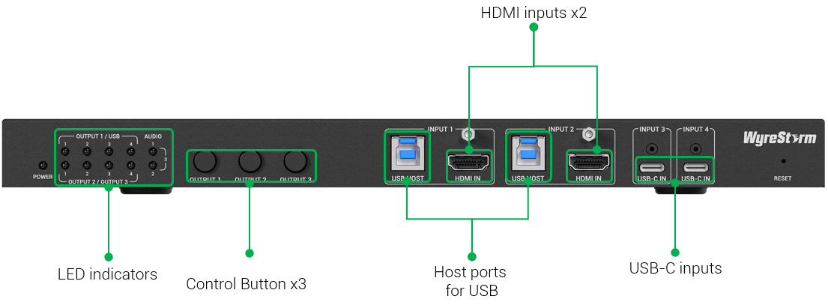
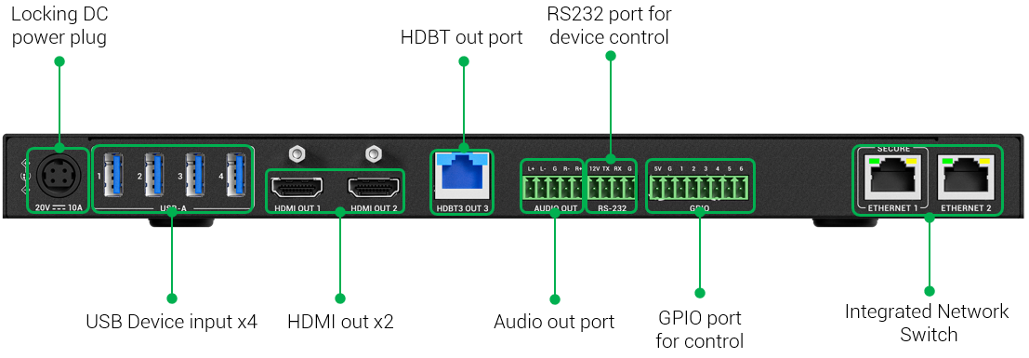
Interface of the Product
Front Panel
Featuring:
2x USB-C Inputs
Ensures secure and stable network access for guests using their PCs, while allowing easy configuration of the system via a web interface.
HDBT Output
Long-distance transmission up to 4K@60Hz4:4:4 over 100m (Cat 6a/7), simplifying installation and providing an effective solution.
USB Hosts & Devices
Provides direct connection for USB peripherals such as cameras, speakerphones, keyboards, and mice, ensuring seamless local device integration and smooth collaboration.
2x Ethernet Ports
Integrated network switch with 2x Ethernet ports, supporting Ethernet bridge and isolation functions for flexible network deployment and device configuration.
Rear Panel

Slide 10
Specifications & Packing List
Main Specifications
Input Video Port | 2x USB-C, 2x HDMI
Output Video Port | 2x HDMI, 1x HDBT
Output Video Signal | HDMI OUT 1: HDMI 2.0, HDCP 2.3 HDMI OUT 2: HDMI 2.0, HDCP 2.3
Input Resolutions (Maximum) | USB-C/HDMI:4K@60Hz 4:4:4 8bit
Output Resolutions (Maximum) | HDMI OUT 1 & 2: 4K@60Hz 4:4:4 8bit HDBT OUT: 4K@60Hz 4:4:4 8bit
Input Audio Port | 2x HDMI, 2x USB-C
Output Audio Port | 2 x HDMI, 1x HDBT 1 x Analog Audio Out
USB Host | USB Host IN 1&2: USB3.2, up to 10Gbit/s
USB Device | USB3.2, up to 10Gbit/s
Ethernet | 1000M/100M adaptive network
Control Method | Front panel buttons, LAN (Web UI & Telnet API), RS-232
Power Supply | 20V 10A DC
What’s in the Box?
1x MX-0403-H3-MST
1x 20V/10A Power Supply (US/UK/EU/AU)
2x USB-C 2m cables
2x USB 3.0 A to B 1.8m Cables
4x Mounting Brackets
4x Bracket Screws
1x 5-pin Phoenix Connector
1x 3-pin Phoenix Connector
1x 8-pin Phoenix Connector
1x Quick Start Guide
Powerful · Reliable · Simple

Slide 11
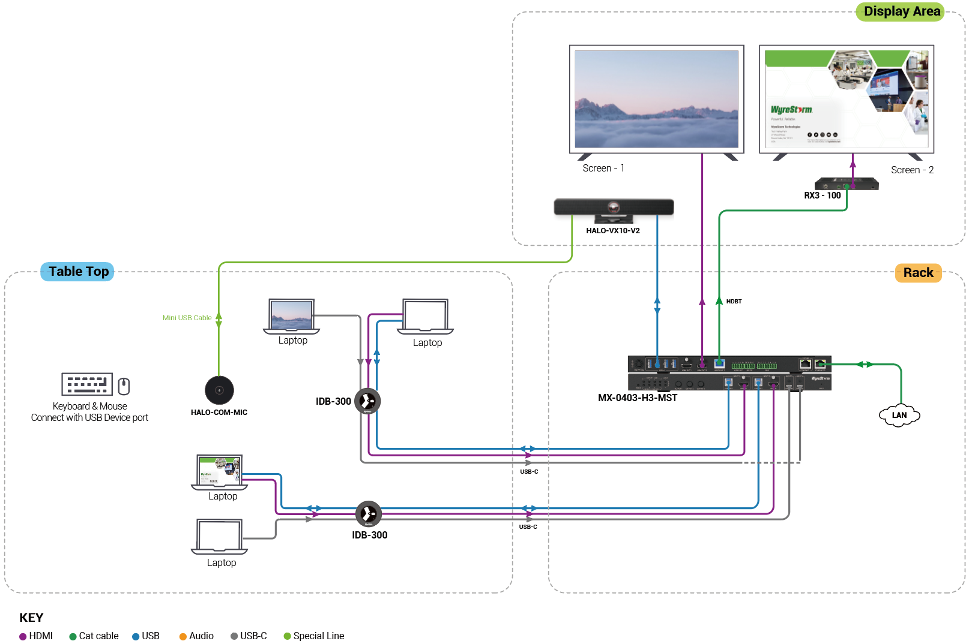
Typical Connection & Applications
Application Scenario 1: Medium Conference Room
Enable seamless collaboration in medium conference rooms by integrating high-quality video, long-distance transmission, hybrid connectivity, and flexible control options. Participants can easily share content, interact with remote colleagues, and enjoy a professional and efficient meeting experience.
Key Benefits Include:
High-quality viewing experience: Deliver up to 4K@60Hz 4:4:4 8bit resolution;
Long-distance transmission: Up to 4K@60Hz 100m (Cat 6a/7), working with RX3-100;
Hybrid teaching & meeting : Connect to videobar, keyboard and mouse, we offer professional hybrid experience.
Powerful Ethernet capability: 2x Ethernet ports for Ethernet bridge and Ethernet isolation, USB Hosts also support Ethernet passthrough;
Flexible control methods : Working with IDB-300 or Web-UI make the control easier ;

Slide 12
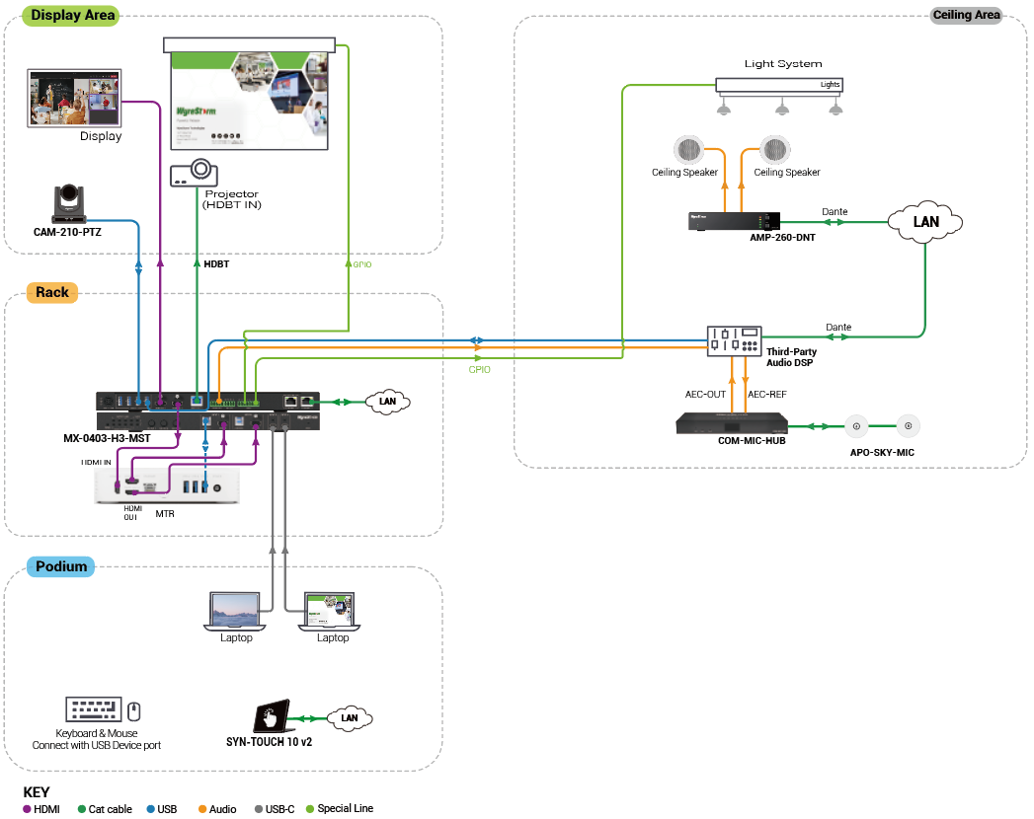
Typical Connection & Applications
Application Scenario 2: Medium Conference Room (Hybrid)
Deliver a professional hybrid conferencing solution for medium rooms by combining high-quality video, advanced audio integration, and reliable long-distance transmission. Both in-room and remote participants can clearly see, hear, and interact with each other, creating an efficient and engaging collaboration environment.
Key Benefits Include:
High-quality viewing experience: Deliver up to 4K@60Hz 4:4:4 8bit resolution;
Long-distance transmission: Up to 4K@60Hz 100m (Cat 6a/7), working with RX3-100;
Provide professional audio performance: Integrate with external audio DSPs, amplifiers, microphones, and ceiling speakers to enhance the audio experience
Hybrid teaching & meeting : Connect to CAM-210-PTZ, extra audio system, and keyboard and mouse, we offer professional hybrid experience.
Powerful Ethernet capability: 2x Ethernet ports for Ethernet bridge and Ethernet isolation, USB Hosts also support Ethernet passthrough;
Flexible control methods : Cooperating with Web-UI, SYN- TOUCH10 make the control easier;

Slide 13
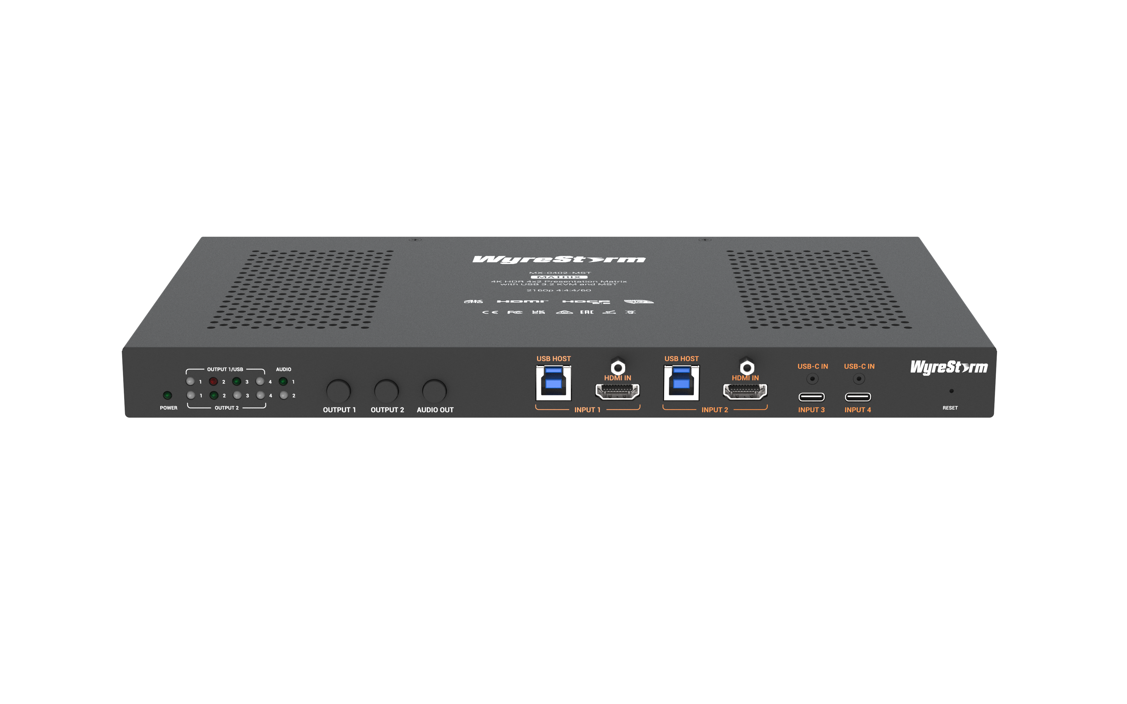
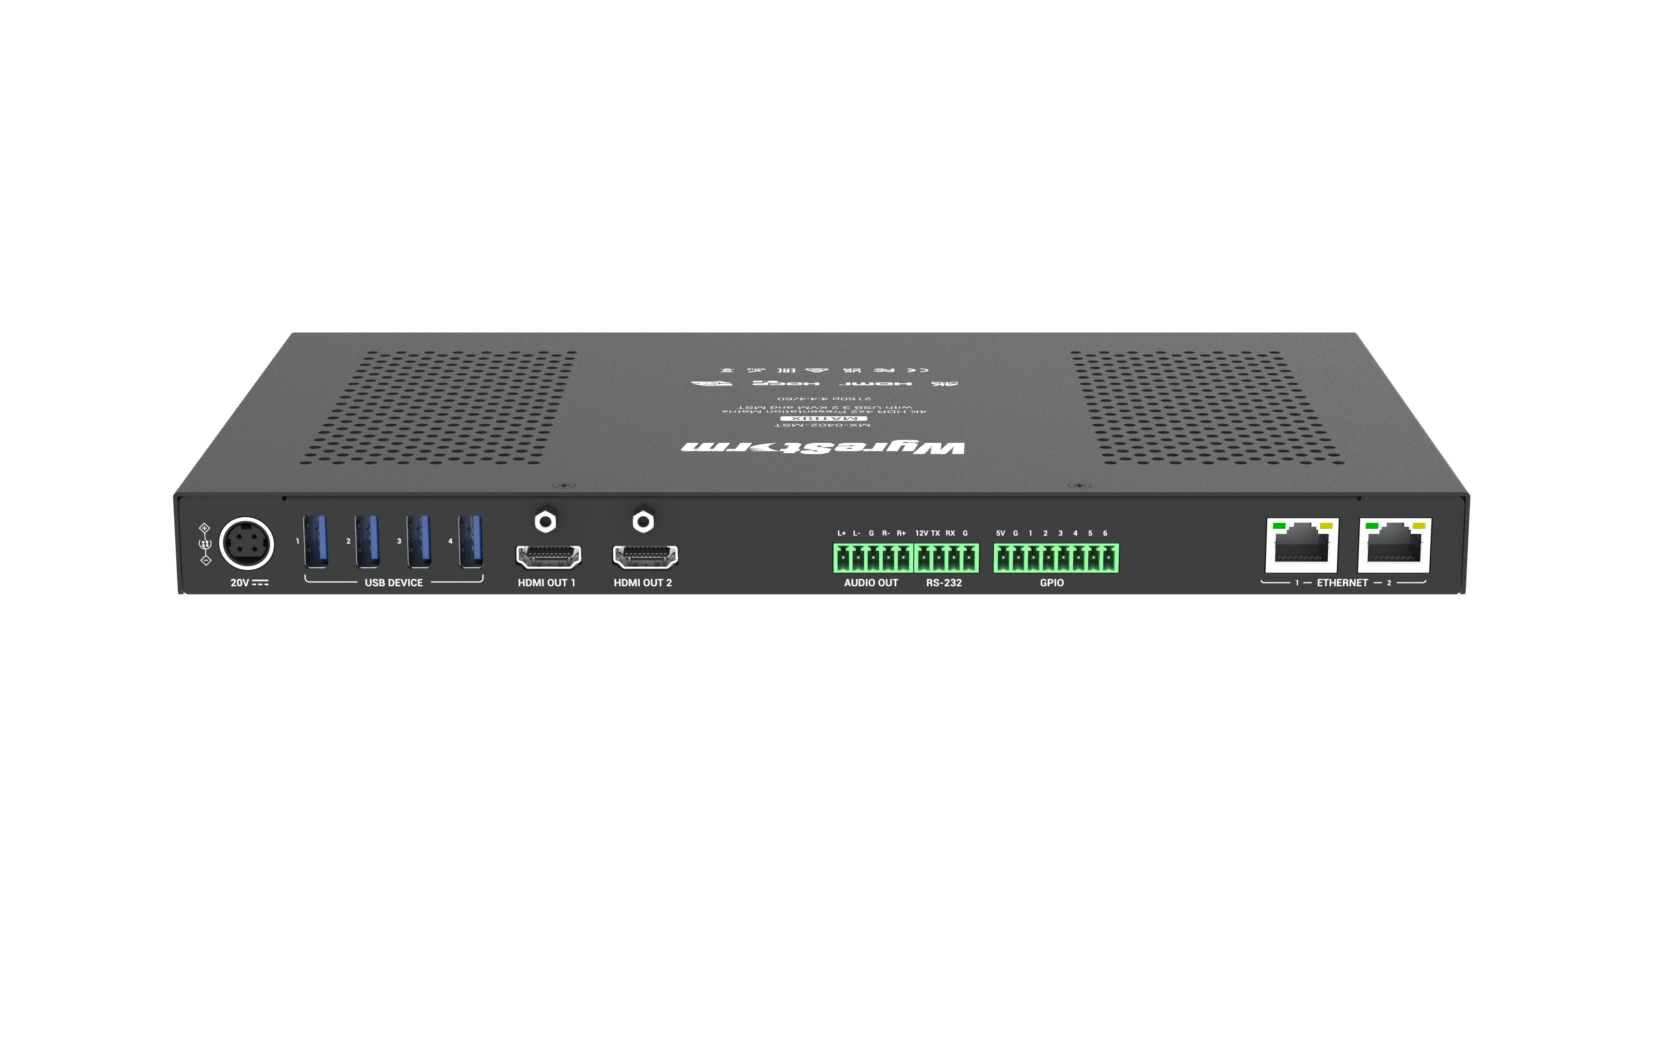
History of Previous Products
MX-0402-MST
VIDEO
High-quality resolution:4K@60Hz 4:4:4 8 bit, HDCP2.3
Full-featured USB-C: supports AV, USB, 60W PD and 1G network to laptop
Support MST: output 2 different images from 1 USB-C laptop to 2 displays
Dual Outputs：(Do not support long-distance transmission [HDBT output] comparing with MX-0403-H3-MST)
USB
Built-in 4x USB Host (2x USB-C built-in, 2x USB HOST) and 4x USB3.0 ports, ideal for hybrid meeting and hybrid teaching
USB Host delivers 1G network to PC/laptop
CONTROL
Work with SYN-TOUCH10 for Smart Control
RS232, GPIO
Pair with IDB-300-BTN/IDB-300 for tidy setup and efficient control.
AUDIO
Balanced De-embedding Audio Out
ETHERNET
Ethernet Isolation, Ensure Network Security
Ethernet extension, when there’s no enough network cables
USB HOST supports Ethernet pass through, easy to enjoy the networking
Powerful · Reliable · Simple

Slide 14
Comparison with Other Competitors
 | WyreStorm |  | Lightware
Model | MX-0403-H3-MST | UCX-4x3-HC40-BD (New) | UCX-4x3-TPX-TX20 | UCX-4x3-TPN-TX20 (New) | UCX-4x3-HCM40 (New)
HDMI input | 2x HDMI, HDMI2.0 | 2x, HDMI2.0 | 2x, HDMI2.0 | 2x, HDMI2.0 | 2x, HDMI2.0
USB-C | 2x USB-C, USB3.2 Gen2 10Gbit/s | 2x, USB3.1 Gen1 5Gbit/s | 2x, USB3.1 Gen1 5Gbit/s | 2x, USB2.0 480Mbit/s | 1x, USB3.1 Gen1 5Gbit/s
Output | HDMI Output x 2 HDBT Output x1 | HDMI Output x 3 | HDMI Output x 2 AVP Output x 1 | HDMI Output x 2 AVP Output x 1 | HDMI Output * 3
HDBT/AVP | HDBT 3.0 out | No | Yes/AVP * Point to point | Yes/AVP * over Ethernet switch | No
PoE | No | No | Yes | No | No
Dual Screen Expansion (MST) | Yes | No | Yes | No | DP Alt + DisplayLink
Resolution | 4K@60Hz 4:4:4 8bit | 4K@60Hz 4:4:4 8bit | 4K@60Hz 4:4:4 8bit | 4K@60Hz 4:4:4 8bit | 4K@60Hz 4:4:4 8bit
Audio out | Yes | Yes | Yes | Yes | Yes
No FAN (No noise) | Yes | No | No | No | No
KVM Host | 2x USB Host 2x USB-C (USB host built-in) | 1x USB Host 1x USB-C | 2x USB Host (Type-B) | 2x USB Host 2x USB-C | 1x USB Host (Type-B)
USB Device | USB 3.0 |  |  | USB 2.0
KVM Device | 4x USB Device (Type-A) | 4x USB Device (Type-A) | 4x USB Device (Type-A) | 4x USB Device (Type-A) | 4x USB Device (Type-A)
Host Switching | Yes | Yes | Yes | Yes | Yes
Ethernet | 2x Ethernet | 4x: 3x Ethernet, 1x Dante | 3x: 3x Ethernet | 3x: 3x Ethernet | 3x
USB to Ethernet Bridge | All USB-C/B | USB-C only | USB-C only | USB-C only | No
RS232 | Yes | Yes | Yes | Yes | Yes
GPIO | Yes | Yes | Yes | Yes | Yes
OCS Sensor (with 24V power supply) | Yes | Yes | No | Yes | Yes
Panel Control Button | Yes | Yes | Yes | Yes | Yes
USB-C Charging | 60W+60W | 100W (120W total) | 100W (120W total) | 100W (120W total) | 100W (120W total)

Slide 15
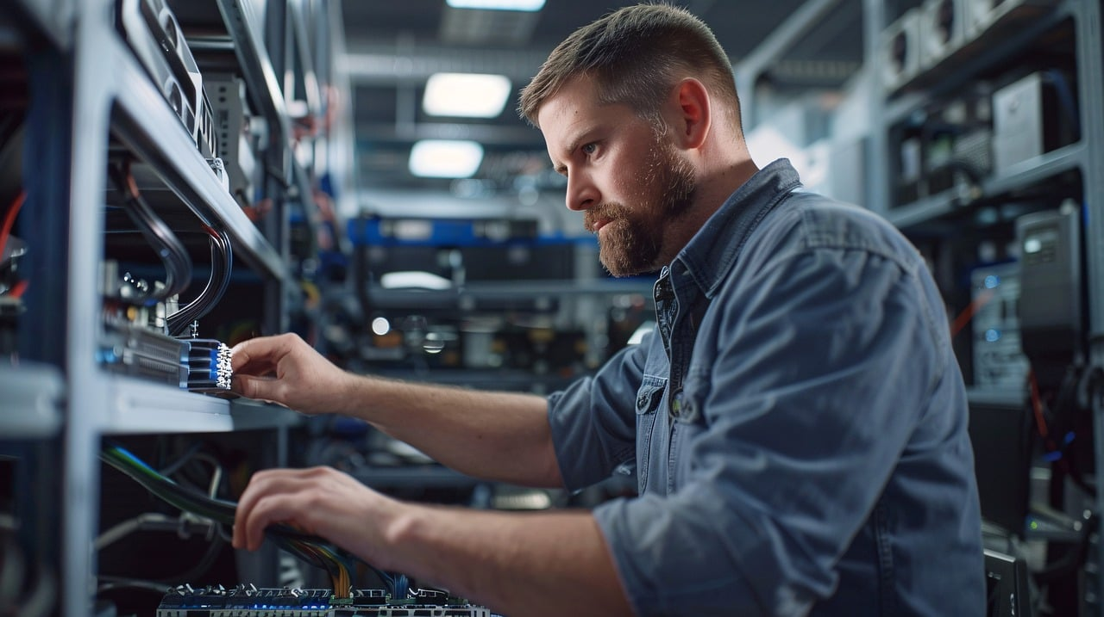
Quick Installation Guide
Effortlessly set up your presentation switcher with simple steps, ensuring seamless configuration and an exceptional viewing experience.
Connect Interfaces: Follow the standard product connection guidelines and customize connections based on your environment’s layout for optimal performance.
Start the Device: Use SmartGUI to locate the device's IP address, then log into the Web-UI for easy equipment configuration.
Create Your Hybrid Environment: Create your video, audio, USB settings using the Web-UI. For detailed instructions, refer to the user manual..
Enjoy Superior Visuals: Experience stunning video clarity and immersive visuals tailored to your needs.
Powerful · Reliable · Simple

Slide 16
Important Notes for Installation
Ensure all cables are securely connected to avoid performance issues.
Check your network settings and confirm that the device is on the correct subnet.
Double-check configuration settings in the Web-UI to optimize display and functionality.
For complex installations, refer to the documentation or seek professional assistance if necessary.
Powerful · Reliable · Simple

Slide 17
Introduction of Web Configuration Interface
The Web UI of the MX-0403-H3-MST presentation switcher is designed for intuitive device management and control through any web browser. With the Web UI, you can easily configure and customize your own settings with the following features:
Web UI Functionality:
Interface: Effortlessly manage device settings via a web browser.
Setting up: Video routing, audio control, and USB settings or other general settings such as Ethernet, RS232, CEC, etc.
Control: Set up and adjust video inputs, outputs, and EDID profiles.
Key Web UI Configurations:
General: Configure video switching, auto-switching, EDID, and HDCP.
Control: Enable RS-232, GPIO for device control and CEC for display control.
Network: Easy setting up about Ethernet capabilities.
System: Configure login password, system log, and perform firmware updates.
Powerful · Reliable · Simple

Slide 18

Final Thoughts
Q & A Session
Got questions? Don't hesitate to ask away.
Powerful · Reliable · Simple

